Slide 1
English Grammar
Third Edition
Chapter 4: Future Time
清雲科技大學應用外語系
副教授: 陳徵蔚

Slide 2
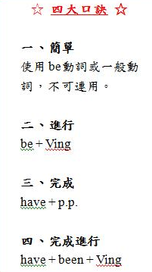

Slide 3
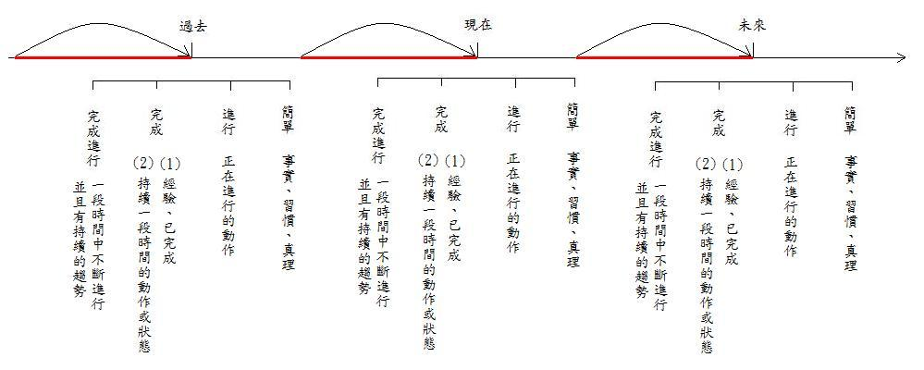

Slide 4
4-1 Simple Future: will, Be going to
Jack will finish his work tomorrow.
Jack is going to finish his work tomorrow.
Anna will not be there tomorrow.
From: English Grammar P.51

Slide 5
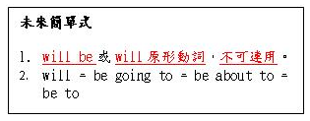

Slide 6
4-2 WILL vs. BE GOING TO
To express a Prediction: Use either WILL or BE GOING TO
According to the weather report, it will be cloudy tomorrow.
(C) Watch out! You’re going to hurt yourself!
From: English Grammar P.52

Slide 7
4-2 WILL vs. BE GOING TO
To express a Prior Plan: Use only BE GOING TO
(e) A: Why did you buy this paint?
B: I’m going to paint my bedroom tomorrow.
From: English Grammar P.52

Slide 8
4-2 WILL vs. BE GOING TO
To express WILLLINGNESS : Use only WILL
(g) A: The phone’s ringing.
B: I’ll get it.
From: English Grammar P.52

Slide 9
4-3 Expressing the future in the clauses
Bob will come soon. When Bob comes, we will see him.
(f) While I am traveling in the Europe next year, I’m going to save money by staying in youth hotels.
(h) I will go to bed after I have finished my work.
From: English Grammar P.55

Slide 10
4-4 Using the present progressive and the simple present to express future time
Present Progressive
My wife has an appointment with a doctor. She is seeing Dr. North next Tuesday.
Sam has already made his plans. He is leaving at noon tomorrow.
From: English Grammar P.57

Slide 11
4-4 Using the present progressive and the simple present to express future time
Simple Present
(d) The museum opens at ten tomorrow morning.
(e) Classes begin next week.
From: English Grammar P.57

Slide 13
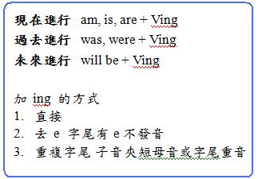

Slide 14
4-5 Future Progressive
(b) Right now I am sitting in class. At this same time tomorrow, I will be sitting in class.
(c) Don’t call me at night because I won’t be home. I am going to be studying at the library.
(d) Don’t get impatient. She will be coming soon.
From: English Grammar P.60

Slide 16
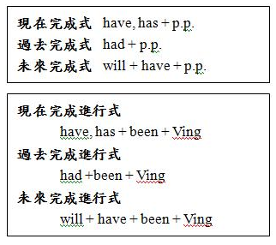

Slide 17
4-6 Future Perfect
I will graduate In June. I will see you in July. By the time I see you, I will have graduated.
I will have finished my home work by the time I go out on a date tonight.
From: English Grammar P.62

Slide 20
4-7 Future Perfect Progressive
(c) I will go to bed at ten P.M. Ed will get home at midnight. At midnight I will be sleeping. I will have been sleeping for two hours by the time Ed gets home.
(d) When Professor Jones retires next month, he will have taught for 45 years.
From: English Grammar P.62

