Slide 1
English Grammar
Third Edition
Chapter 2:
Present and past,
simple and progressive
清雲科技大學應用外語系
副教授: 陳徵蔚

Slide 2


Slide 3


Slide 4
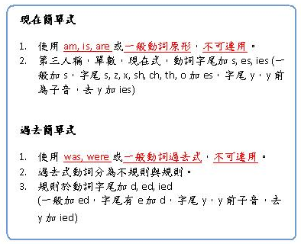

Slide 5
2-1 Simple Present
(a) The average person breathes 21,600 times a day.
(e)I get up at seven every morning.
From: English Grammar P.13

Slide 7
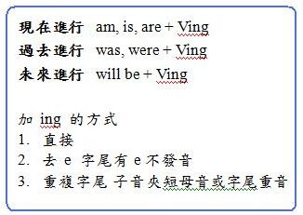

Slide 8
2-2 Present Progressive
(h) I need an umbrella because it is raining.
(K) John is trying to improve his work habits.
From: English Grammar P.13

Slide 9
2-3 Stative Verbs
(a) Yum! This food tastes good. I like it very much.
(c) The chef is in his kitchen. He is tasting the sauce.
(d) It taste too salty.
From: English Grammar P.15

Slide 10
2-4 AM/IS/ARE BEING + Adj.
(a) Ann is sick today.
(b) Jack doesn’t feel well, but he refuse to see a doctor. He is being foolish.
(d) incorrect: Mr. Smith is being old.
correct: Mr. Smith is old.
From: English Grammar P.17

Slide 11
2-8 Troublesome Verb: RAISE/RISE,SET/SIT,LAY/LIE
TRANSITIVE | INTRANSITIVE
raise, raised, raised Tom raised his hand. | (b) rise, rose, risen The sun rises in the east.
(c) set, set, set I will set the book on the desk. | (d) sit, sat, sat I sit in the front row.
(e) lay, laid, laid I am laying the book on the desk. | (f) lie,**lay, lain He is lying on his bed.
From: English Grammar P.26

Slide 14
2-9 Simple Past
(a)I walked to school yesterday.
(c) I bought a new car three days ago.
(d) Rita stood under a tree when it began to rain.
From: English Grammar P.27

Slide 17
2-10 Past Progressive
(g) I was walking down the street when it began to rain.
(j) At eight o’clock last night, I was studying.
(i) While I was studying in one room of our apartment, my roommate was having a party in the other room.
From: English Grammar P.28

Slide 18
2-11 Using progressive verbs with
Always to complain
(a) Mary always leaves for school at 7:45.
(b) Mary is always leaving her dirty socks on the floor for me to pick up! Who does she think I am ? Her maid?
From: English Grammar P.30

Slide 19
(c) I am always/ forever/ constantly picking up Mary’s dirty socks!
(d) I didn’t like having Sam for my roommate last year. He was always leaving his dirty clothes on the floor.
From: English Grammar P.30

Slide 20
2-12 Using expressions of place with progressive verbs
(b) - Where’s Kay?
- She’s in her room studying.
(d) – What was Jack doing when you arrived?
- He was reading a book in bed.

