Slide 1
English Grammar
Third Edition
Chapter 3 :
Prefect and Prefect Progressive Tenses
清雲科技大學應用外語系
副教授: 陳徵蔚

Slide 2


Slide 3
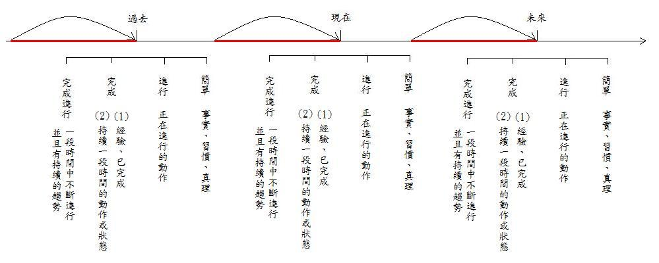

Slide 4
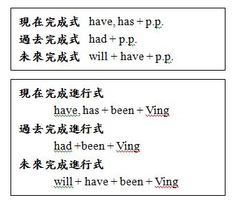

Slide 5
3-1 Present Perfect
They have moved into a new apartment.
Have you ever visited Mexico?
I have never seen snow.
From: English Grammar P.36

Slide 6
We have had four tests so far this semester.
I have written my wife a letter every other day for the last two weeks.
I have met many people since I came here in June.
From: English Grammar P.36

Slide 7
I have been here since seven o’clock
We have been here for two weeks.
I have had this same pair of shoes for three years.
From: English Grammar P.36

Slide 9
3-2 Present Perfect Progressive
Right now I am sitting at my desk
I have been sitting here since seven o’clock.
I have been sitting here for two hours.
You have been studying for five straight hours. Why don’t you take a break?
From: English Grammar P.42

Slide 10
I have been thinking about changing my major.
My back hurts, so I have been sleeping on the floor lately. The bed is too soft.
He has been working at the same store for ten years.
From: English Grammar P.42

Slide 13
3-3 Past Prefect
Sam had already left by the time Ann got there.
c) Sam had already left when Ann got there.
e) Sam left before Ann got there.
f) After the guests had left, I went to bed.
From: English Grammar P.45

Slide 15
3-4 Past Perfect Progressive
The police had been looking for the criminal for two years before they caught him.
When Judy got home, her hair was still wet because she had been swimming.
I went to Jane’s house after the funeral. Her eyes were red because she had been crying.
From: English Grammar P.47

